Slide 1

Utilizing Data Analytics to Help Home Buyers
Mohammed Alsalamah

Slide 2



Executive summary
Motivation & goals
Deliverables
Data set
Analytics Dashboard
Deal Fairness Indicator
Future work
Challenges & limitations
Next steps

Slide 3
On average, searching for a home takes more than 100 hours of active work
screenshot
1000s of listings
No filters
Must assess each listing manually
Understand your options
Narrow down choices
Get advice

Slide 4

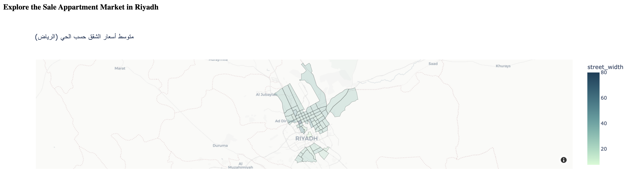

Utilizing analytics tools and machine learning reduces search time by up to 50%
Goal
Approach
Example
Gain insight into market
Develop analytical dashboard
Great deal! This apartment is listed at 10% lower than its fair value.
Narrow down option
Price fairness indicator

Slide 5
Executive summary
Motivation & goals
Deliverables
Data set
Analytics Dashboard
Deal Fairness Indicator
Future work
Challenges & limitations
Next steps

Slide 6
We gathered data of the majority of apartments currently listed for sale in Riyadh, amounting to 7000+ apartments
Attributes
Floor Plan
# Bedrooms
# Bathrooms
Area
Location
Features
Features
Features

Slide 7






We gathered data of the majority of apartments currently listed for sale in Riyadh, amounting to 7000+ apartments
Attributes
Conclusions
Floor Plan
# of Bedrooms
# of Bathrooms
# of Living/Guest rooms
Has Kintchen
# Bedrooms
# Bathrooms
23+ gathered and engineered attributes for each apartment
Some attributes suffer greater levels of inaccuracy
Area
Area (sqr. m)
Dimensions
Length:Width Ratio
Shape Regularity
Location
District
Street Width
Street Direction
Latitude & Longitude
Features
Installed Kitchen
Furnished
Installed AC
Building
Age
Apartment Floor
Online Post
Post ID
Advertisor ID
Advertisor Type (owner)
Advertisor Rating
Time on Market
Last Update

Slide 8
We gathered data of the majority of apartments currently listed for sale in Riyadh, amounting to 7000+ apartments
Attributes
Floor Plan
# of Bedrooms
# of Bathrooms
# of Living/Guest rooms
Has Kintchen
# Bedrooms
# Bathrooms
Area
Area (sqr. m)
Dimensions
Length:Width Ratio
Shape Regularity
Location
District
Street Width
Street Direction
Latitude & Longitude
Features
Installed Kitchen
Furnished
Installed AC
Building
Age
Apartment Floor
Online Post
Post ID
Advertisor ID
Advertisor Type (owner)
Advertisor Rating
Time on Market
Last Update

Slide 9
Providing an analytical dashboard can help home buyers to better understand the market

Slide 10
We are able to narrow down search results by 90%+ without producing any false negatives!
7k
Search results in Aqar.com
>1k
Search results when using our additional filters & filtering for Good and Great deals only

